Slide 1
ME751 Advanced Computational Multibody Dynamics
Section 9.3
February 18, 2010
“Discontent is the first necessity of progress.”
Thomas A. Edison
© Dan Negrut, 2010 ME751, UW-Madison

Slide 2
Before we get started…
Last Time:
Euler Parameters – connection between their time derivative and angular velocity
3D Kinematics of a Rigid Body
Kinematics Analysis
Today:
Geometric Constraints
Basic, Intermediate, High Level
HW5 – due on Feb. 25
Posted online later today
Asking for your feedback – Tu, Feb. 23: Provide anonymously a printed page with two concerns and/or things that I can do to improve ME751

Slide 3
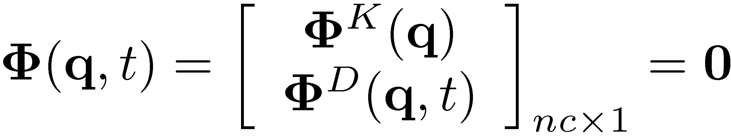


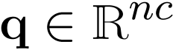
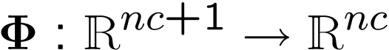
Position Analysis
How do you get the position configuration of the mechanism?
Kinematic Analysis key observation: The number of constraints (kinematic and driving) is equal to the number of generalized coordinates: m=nc
This is a prerequisite for Kinematic Analysis
The solution of the nonlinear system is found by using the so called “Newton-Raphson” algorithm
We’ll elaborate on this later, for now just assume that you have a way to solve the above nonlinear system to find the solution q(t)
IMPORTANT: This is a nonlinear systems with nc equations and nc unknowns that you must solve to find q

Slide 4
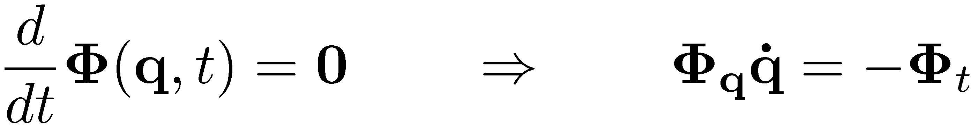


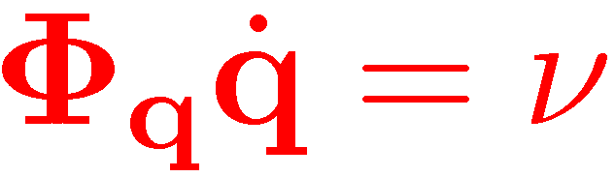
Velocity Analysis
Take one time derivative of constraints Φ(q,t) to obtain the velocity equation:
The Jacobian has as many rows (m) as it has columns (nc) since for Kinematics Analysis, NDOF=nc-m =0
Therefore, you have a linear system that you need to solve to recover

Slide 5



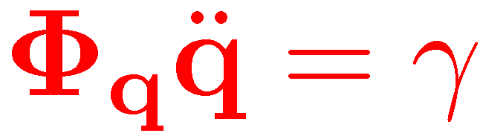
Acceleration Analysis
Take yet one more time derivative to obtain the acceleration equation:
NOTE: Getting right-hand side of acceleration equation is tedious
One observation that simplifies the computation: note that the right side of the above equation is made up of everything in the expression of that does *not* depend on second time derivatives (accelerations)
Just like we pointed out for the velocity analysis, you also have to solve a linear system to retrieve the acceleration

Slide 6
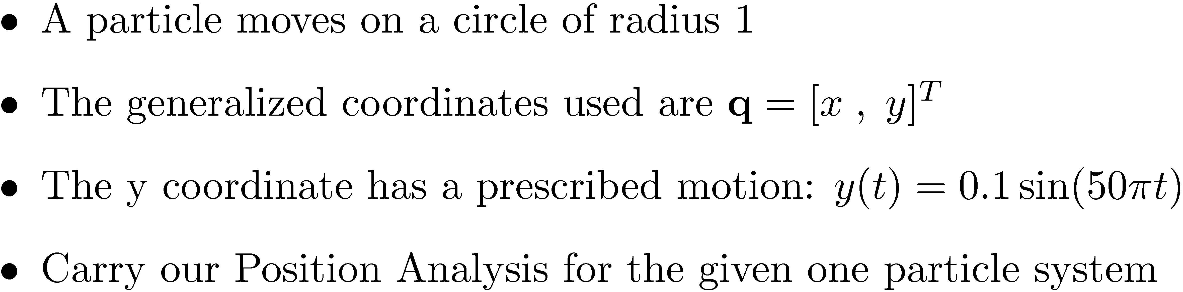
Exercise: Kinematic Analysis

Slide 7
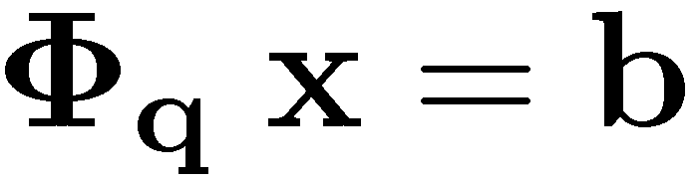
Kinematics Analysis: Comments on the Three Stages
The three stages of Kinematics Analysis: position analysis, velocity analysis, and acceleration analysis they each follow *very* similar recipes for finding for each body of the mechanism its position, velocity, and acceleration, respectively
ALL STAGES RELY ON THE CONCEPT OF JACOBIAN MATRIX:
Φ_{q} – the partial derivative of the constraints wrt the generalized coordinates
ALL STAGES REQUIRE THE SOLUTION OF A SYSTEM OF EQUATIONS
WHAT IS DIFFERENT BETWEEN THE THREE STAGES IS THE EXPRESSION OF THE RIGHT-SIDE OF THE LINEAR EQUATION, “b”

Slide 8
The Drill…
Step 1: Identify the geometry of the motion whenever a constraint is limiting the absolute or relative motion of a body
Step 2: Identify the attributes needed to fully describe the geometric constraint
Step 3: Formulate the algebraic constraint equations Φ(q,t)=0, that capture the effect of the geometric constraint
Step 4: Compute the Jacobian (or the sensitivity matrix) Φ_{q}
Step 5: Compute ν, the right side of the velocity equation
Step 6: Compute γ, the right side of the acceleration equation (tedious…)

Slide 9
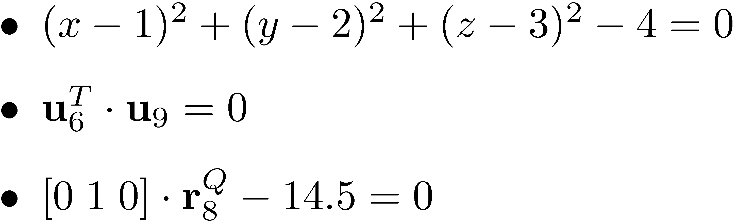
Nomenclature & Notation Conventions
Geometric Constraint (GCon): a real world geometric feature of the motion of the mechanical system
Examples:
Particle moves around point (1,2,3) on a sphere of radius 2.0
A unit vector u₆ on body 6 is perpendicular on a certain unit vector u₉ on body 9
The y coordinate of point Q on body 8 is 14.5
Algebraic Constraint Equations (ACEs): in the virtual world, a collection of one or more algebraic constraints, involving the generalized coordinates of the mechanism and possibly time t, that capture the geometry of the motion as induced by a certain Geometric Constraint
Examples:
Modeling: the process that starts with the idealization of the real world to yield a GCon and continues with the GCon abstracting into a set of ACEs

Slide 10
The GCon Zoo: Basic GCons
We have four basic GCons:
DP1: the dot product of two vectors on two bodies is specified
DP2: the dot product of a vector of on a body and a vector between two bodies is specified
D: the distance between two points on two different bodies is specified
CD: the difference between the coordinates of two bodies is specified
Note:
DP1 stands for Dot Product 1
DP2 stands for Dot Product 2
D stands for distance
CD stands for coordinate difference

Slide 11
The GCon Zoo: Intermediate + High Level GCons
We have two Intermediate GCons:
?1: a vector is ? on a plane belonging to a different body
?2: a vector between two bodies is ? on a plane belonging to the different body
We have a large number of High Level GCons (joints):
Spherical Joint (SJ)
Universal Joint (UJ)
Cylindrical Joint (CJ)
Revolute Joint (RJ)
Translational Joint (TJ)
Other composite joints (spherical-spherical, translational-revolute, etc.)

Slide 12
The GCon Zoo: Overview
Note that there are other GCons that are used, but they see less mileage

Slide 13
Basic GCon: DP1

Slide 14
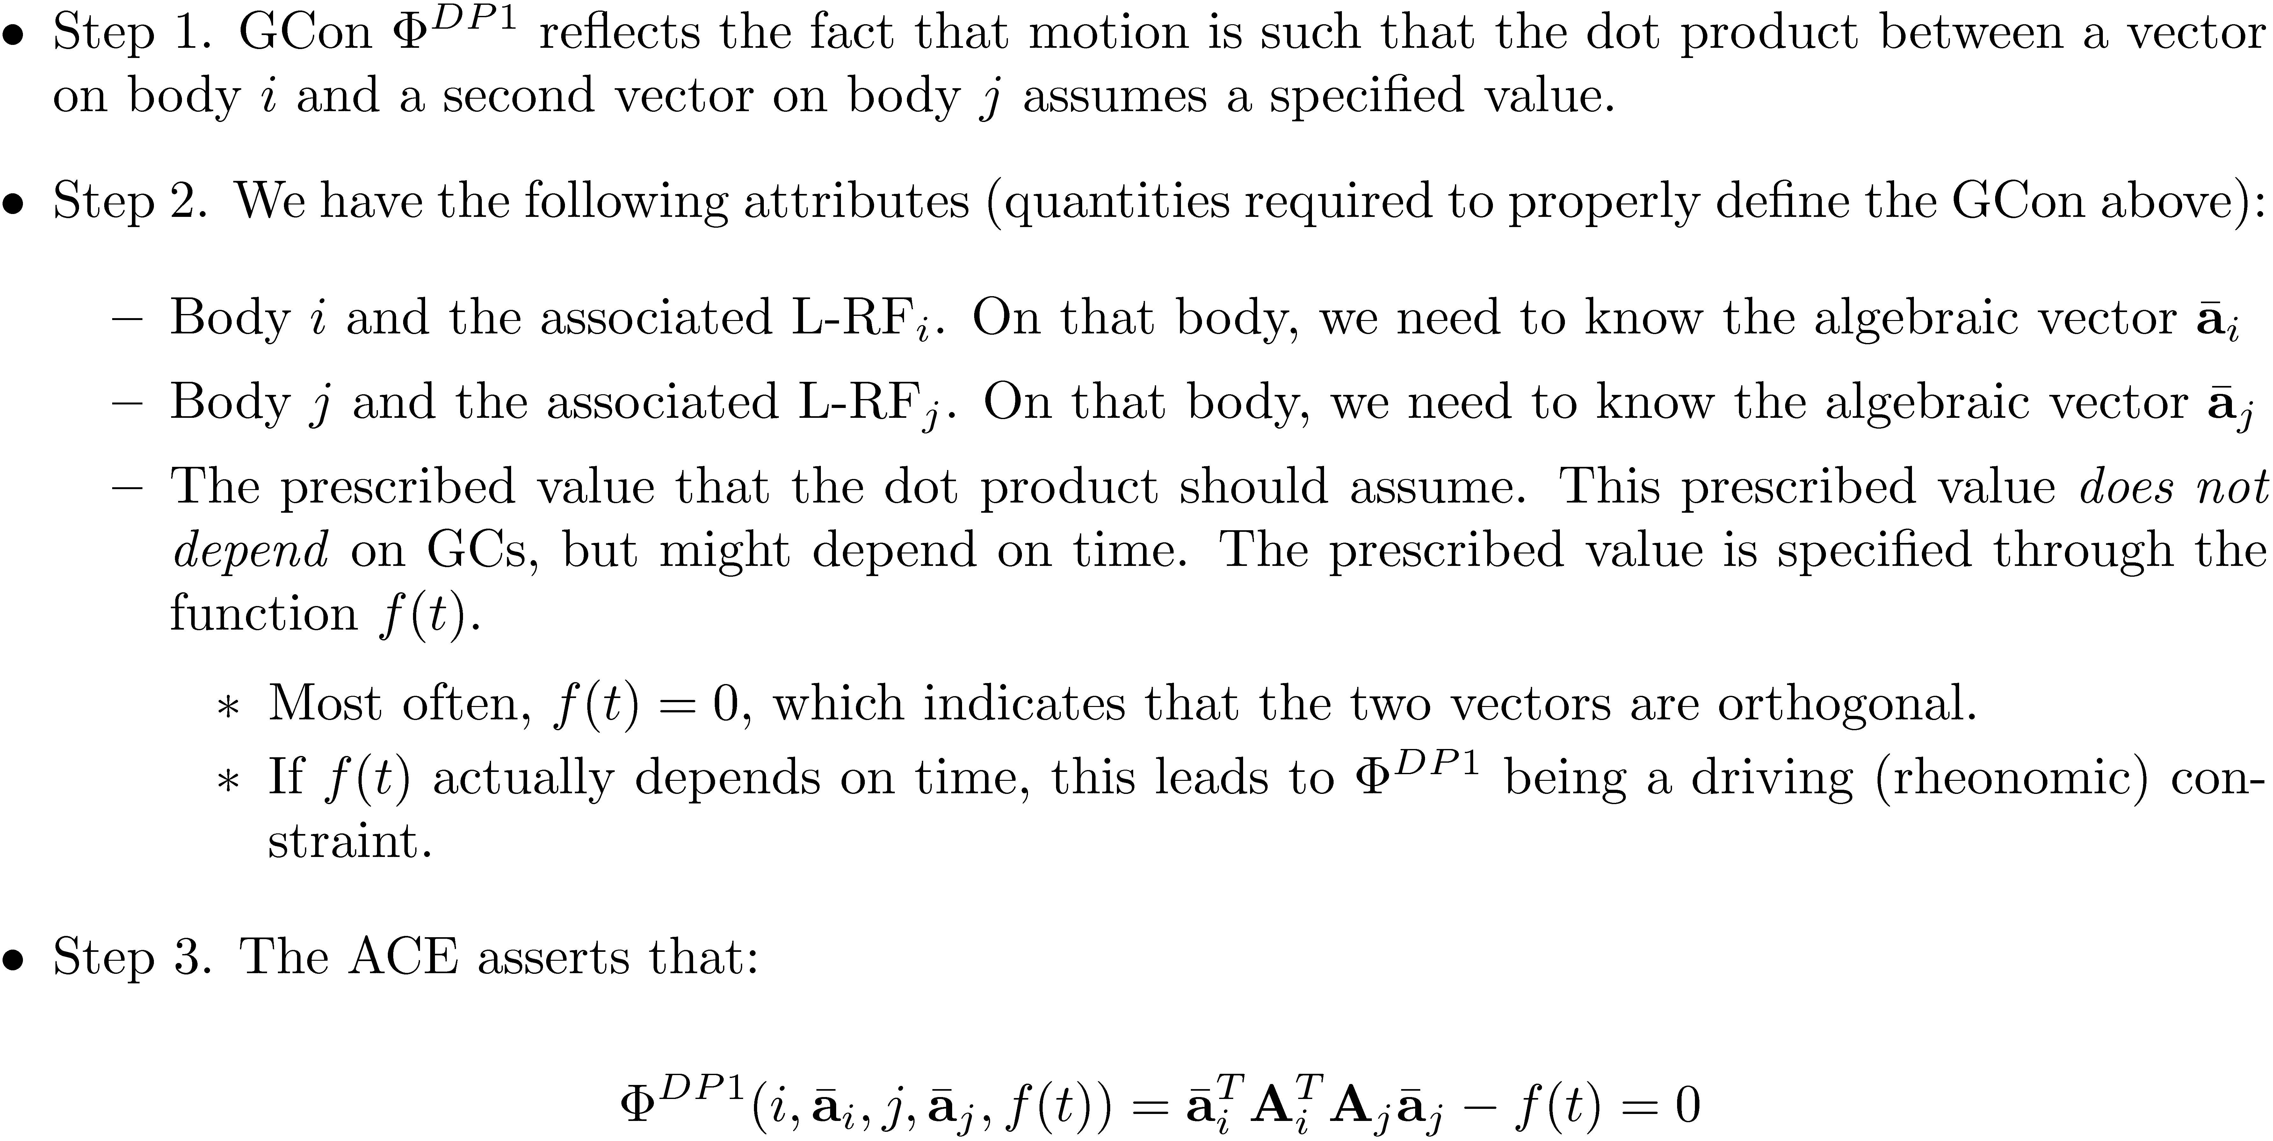
Basic GCon: DP1 [Cntd.]

Slide 15
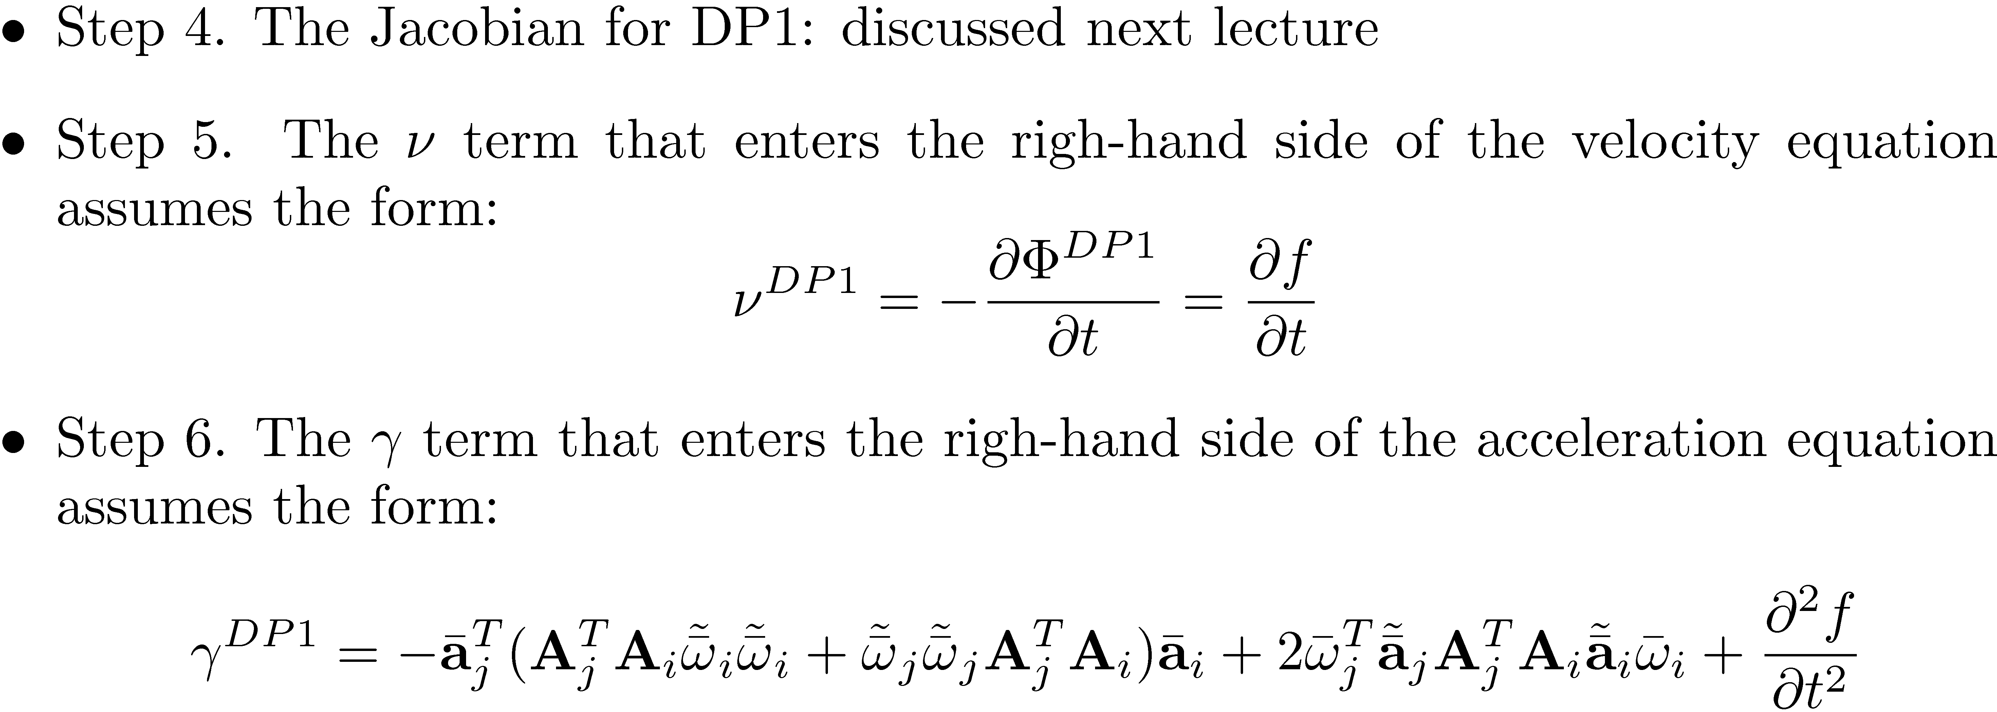
Basic GCon: DP1 [Cntd.]
Note: The ° term only depends on position and velocity information - Important since it is used to compute the acceleration and therefore it should not depend on acceleration (to prevent a circular argument)
GCon-DP1 imposes one ACE and removes one DOF

Slide 16
Basic GCon: DP2

Slide 17
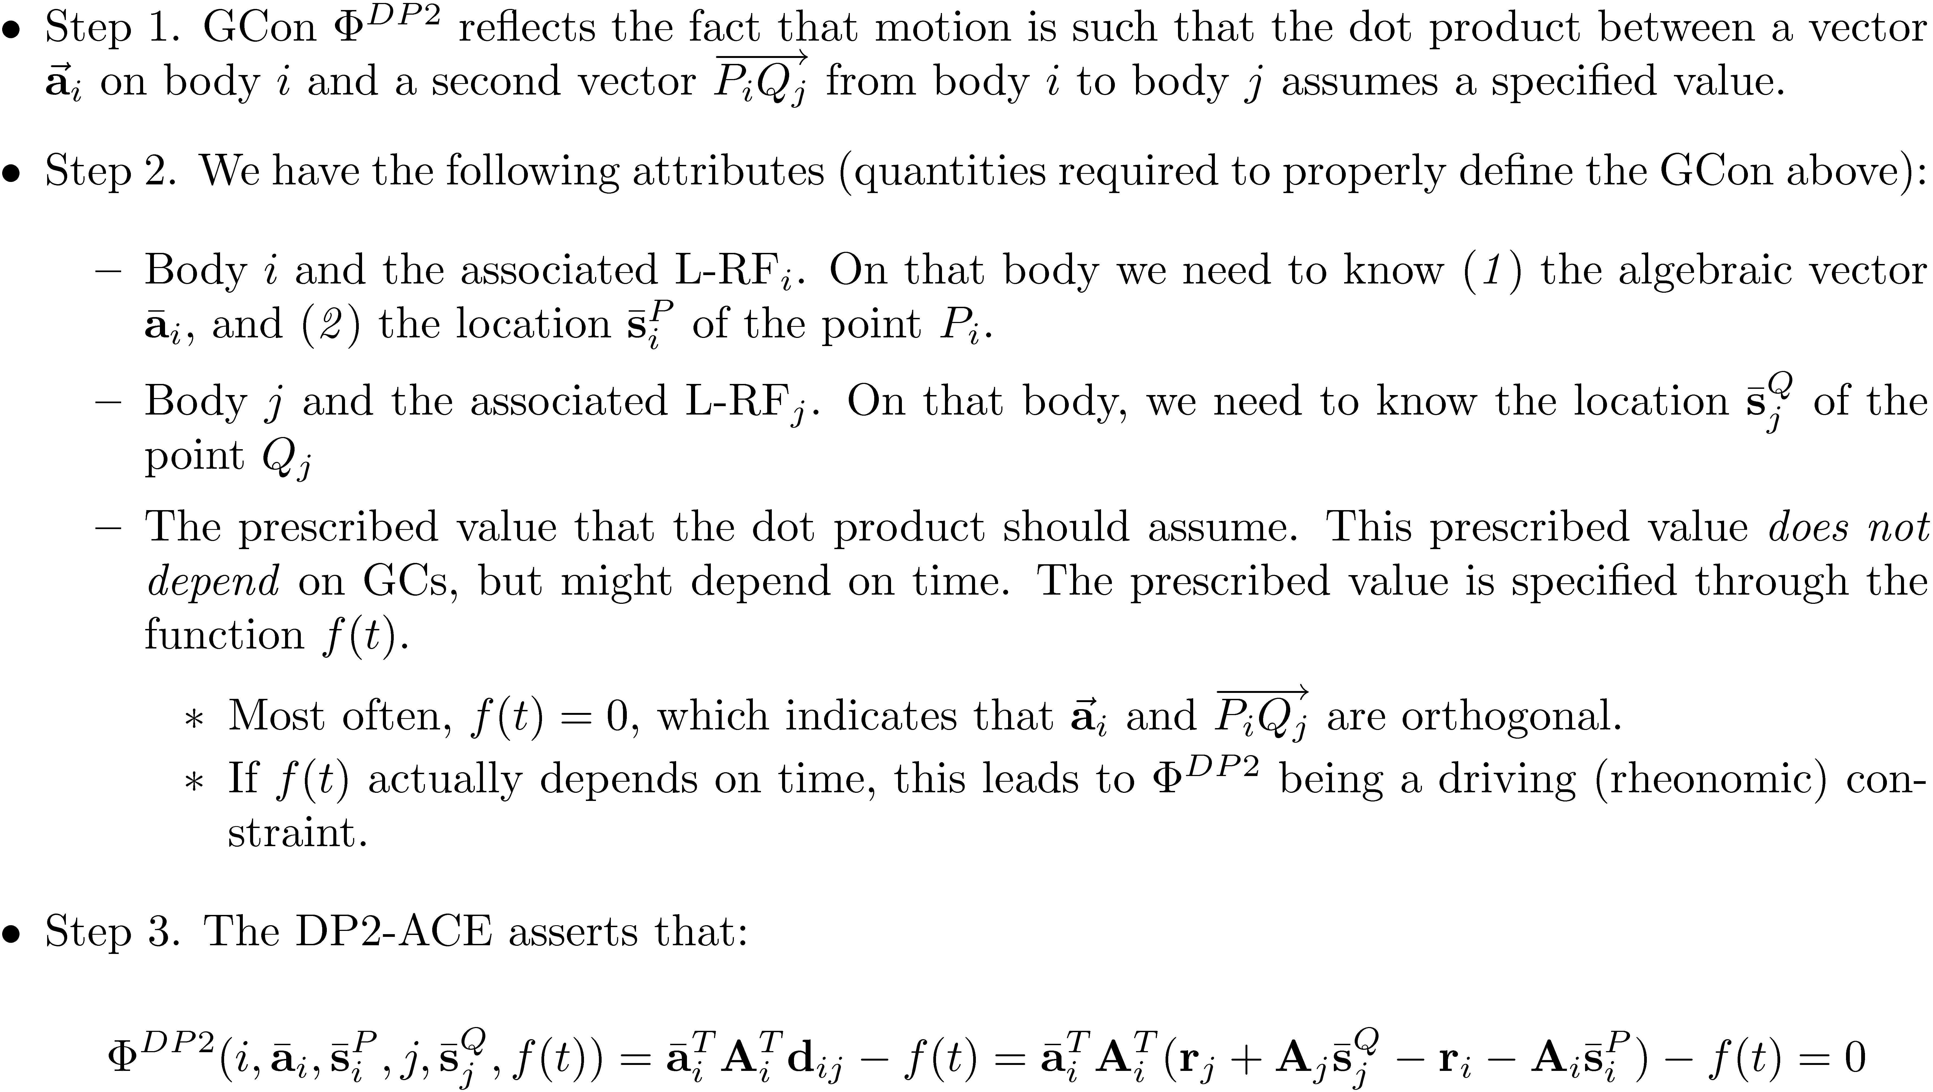
Basic GCon: DP2 [Cntd.]

Slide 18
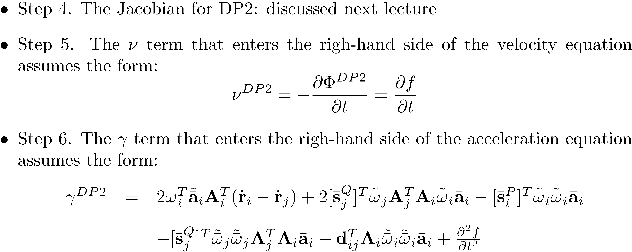
Basic GCon: DP2 [Cntd.]
GCon-DP2 imposes one ACE and as such removes one DOF

Slide 19
Basic GCon: D [Distance]

Slide 20
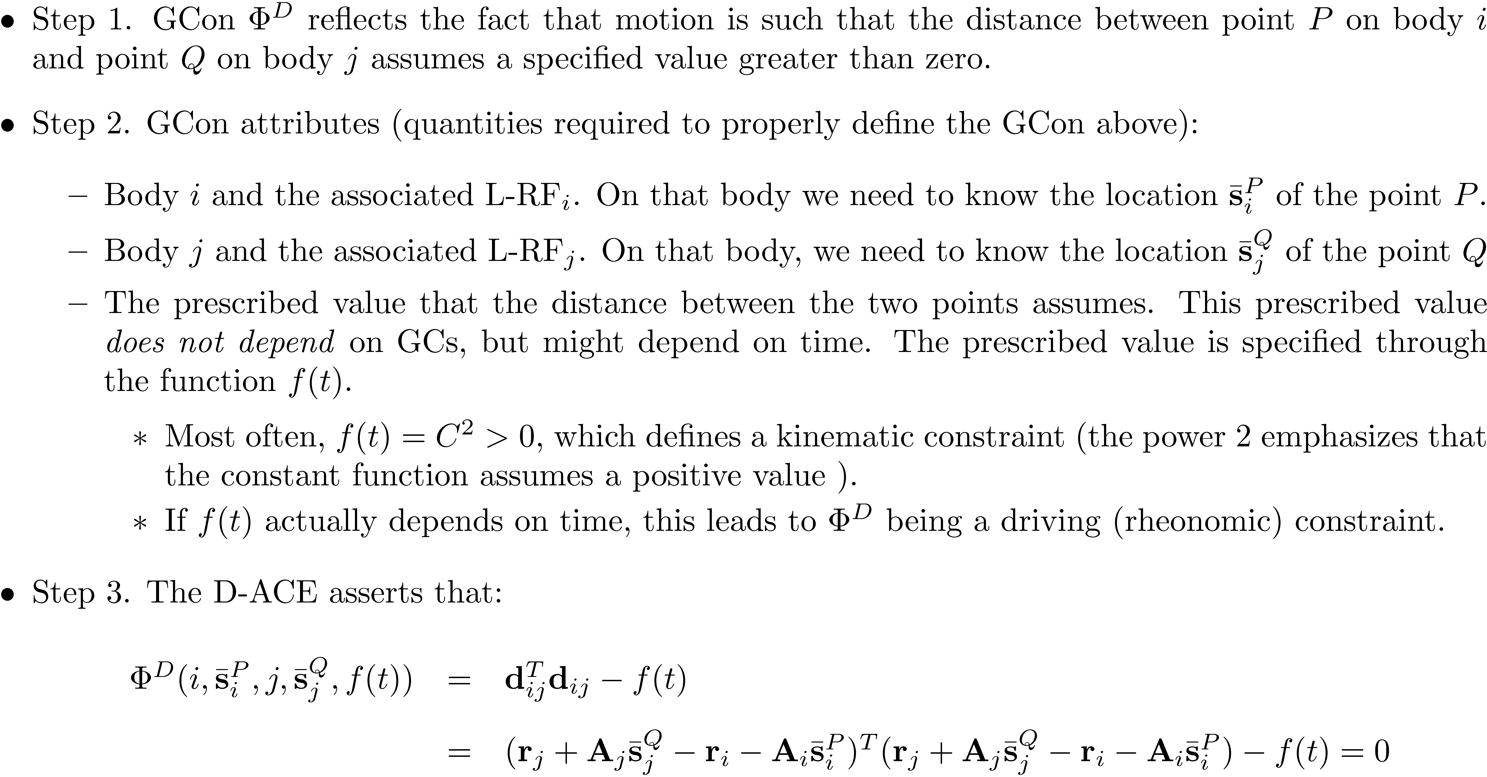
Basic GCon: D [Distance] [Cntd.]

Slide 21
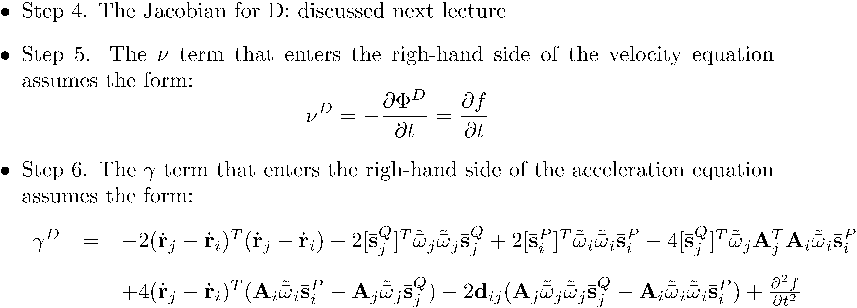
Basic GCon: D [Distance] [Cntd.]
Note: GCon-D imposes one ACE and as such it removes one DOF

Slide 22
Basic GCon: CD [Coordinate Difference] [Cntd.]

Slide 23
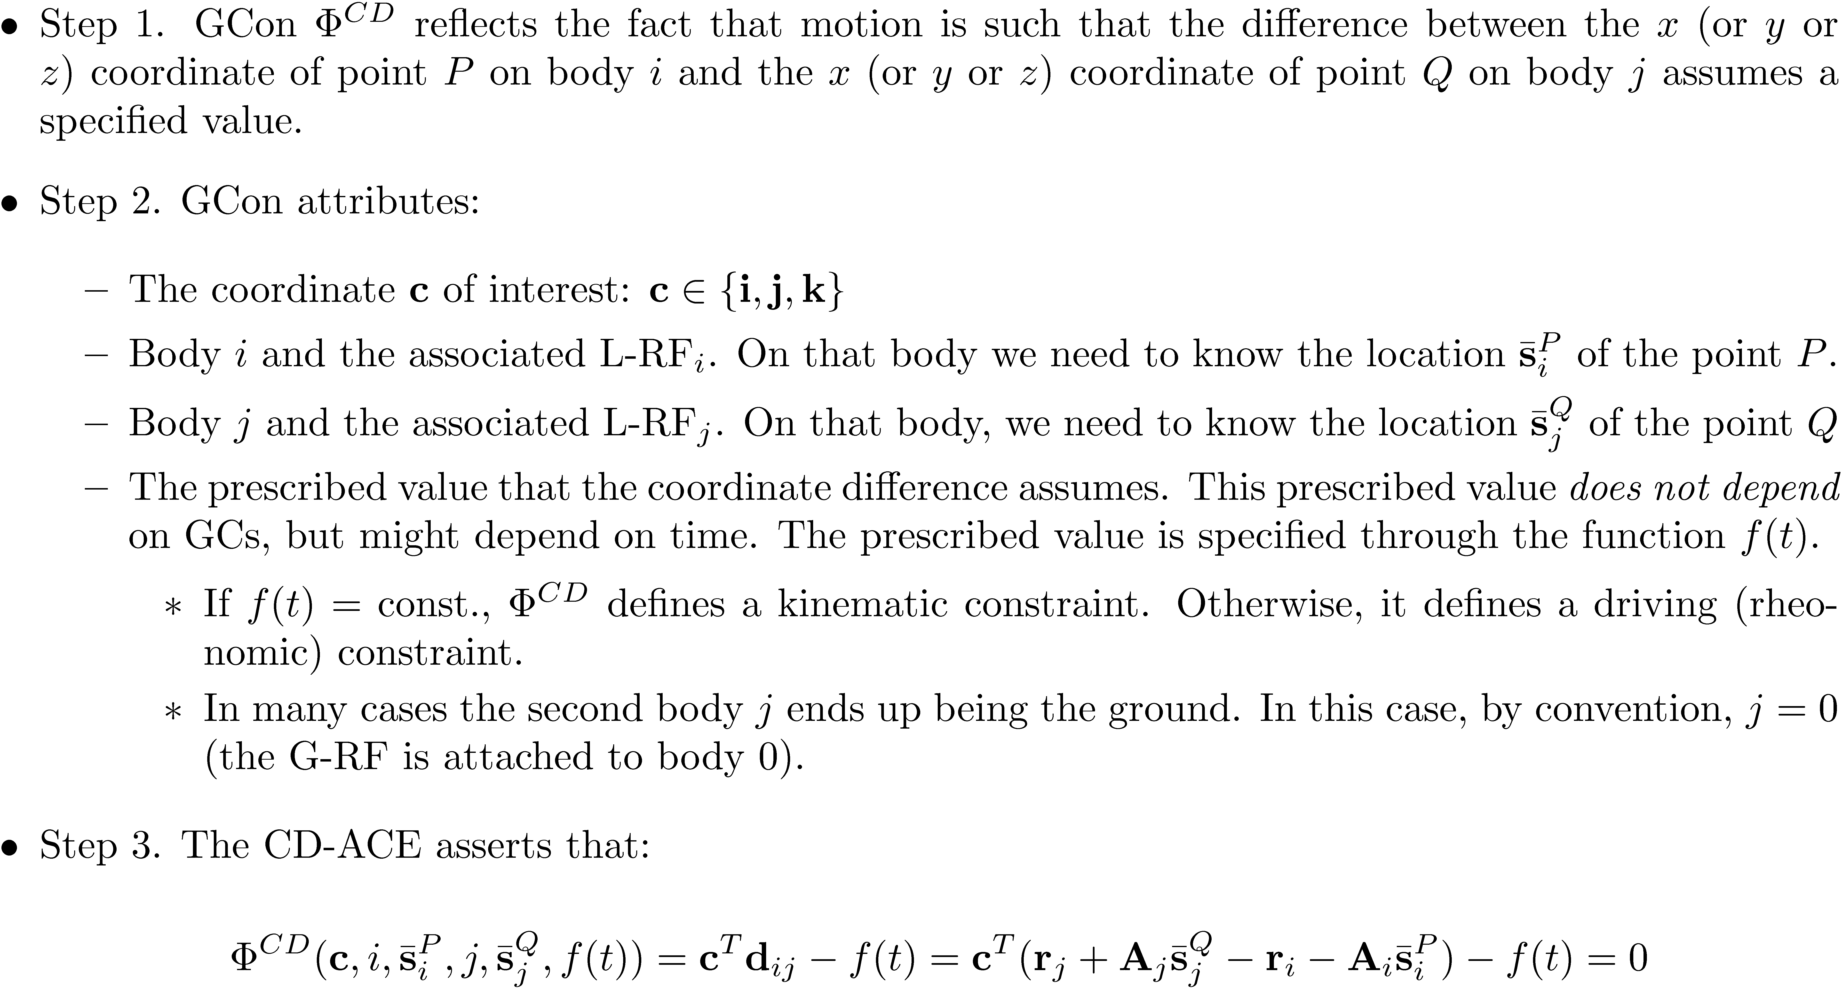
Basic GCon: CD [Cntd.]

Slide 24
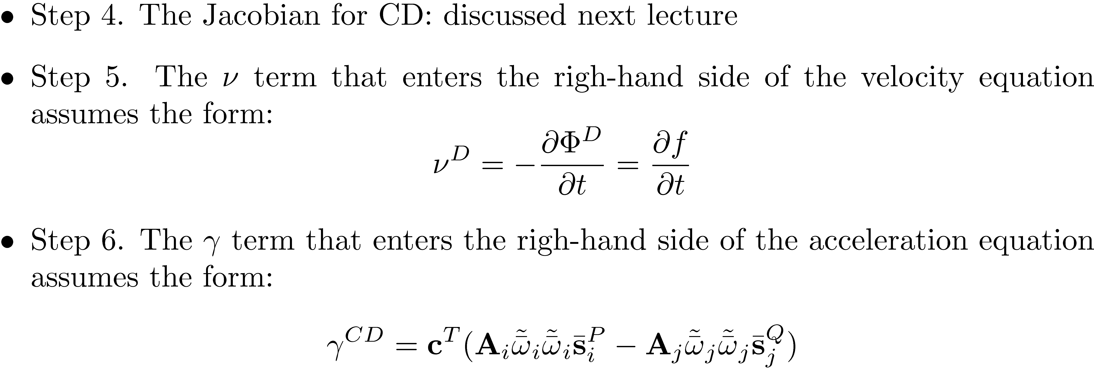
Basic GCon: CD [Cntd.]
Note: GCon-CD imposes one ACE and as such it removes one DOF

Slide 25
Intermediate GCon: ?1 [Perpendicular 1]

Slide 26
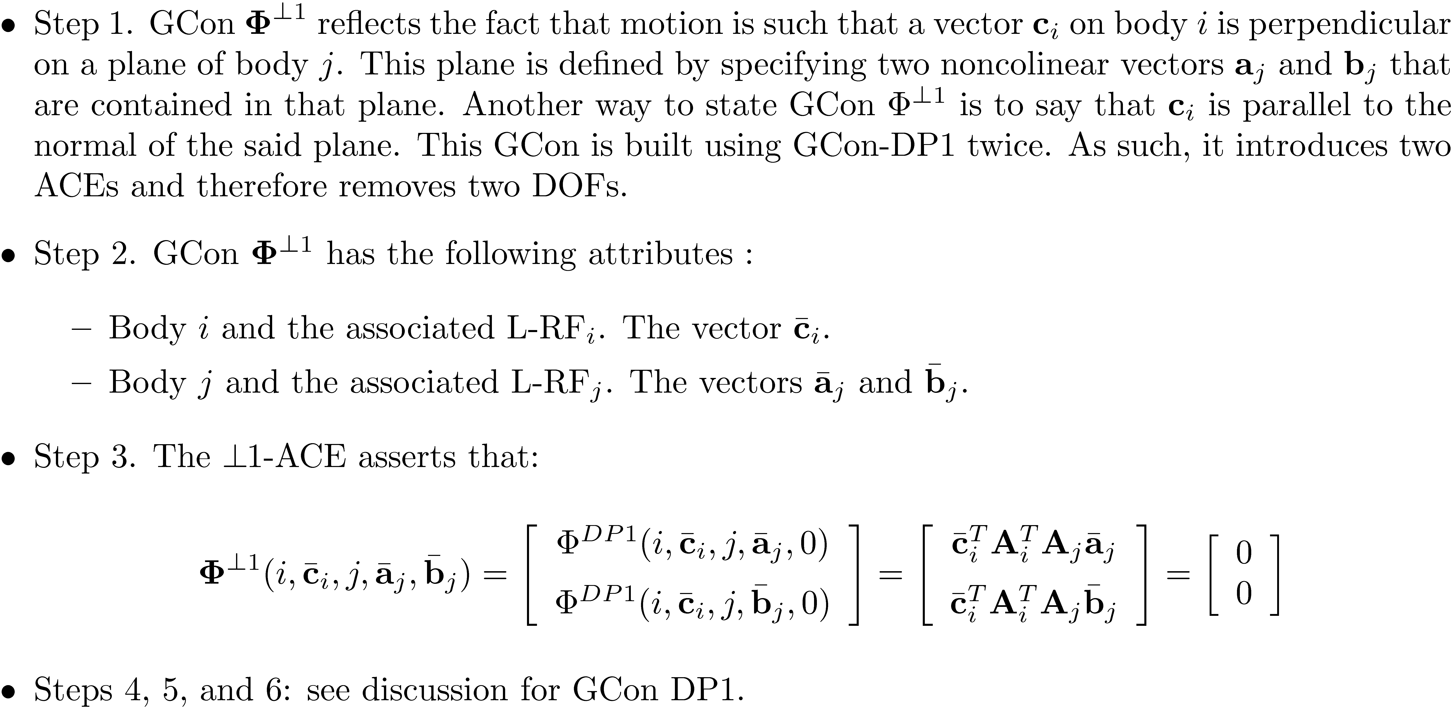
Intermediate GCon: ?1 [Cntd.]

